Slide 1
CPS2 PROJECT
Presented by
Dharmlaingam Dhayananth
Aninda Maulik

Slide 2

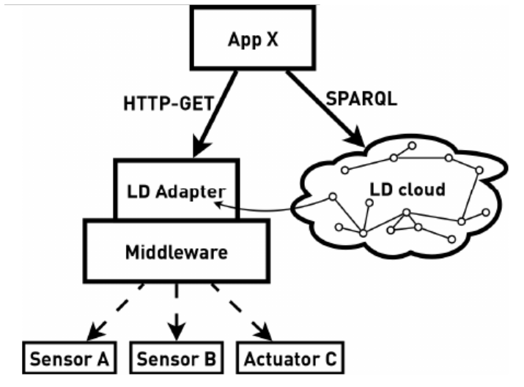
Integrating Industrial Middleware in Linked Data Collaboration Networks (Markus Graube, Leon Urbas and Jan Hladik).
The current digital data is only used for specific task in certain area in industry
Current industry system data is only used in certain area.
The existing approaches are not really standardized.
Standardizing the accessibility and unified information space will bring huge opportunity to industries.
Proposed Linked-Data concept for create an evolutionary information space.
Transformed implementation of OPC UA information space into RDF Triplet format.
Enables human-to-machine and machine-to-communication for control and maintenance.

Slide 3
Proposed Linked Data Adapter for OPC UA to integrate transient data to Linked-data.
The linked data adapter exists in middle wear and allows to get dynamic data with a REST request.
Implemented an approach with URL_DEREFERENCING concept (two named graph)
Transient data queried only when it is demanded.
The OPC Node information and resource information also stored to triple store.
Failed to map other features of OPC UA like TypeReference and Filters
Not supported many built in function of OPC UA including filter functions
Limited SPARQL query feature in the LINKED-ADAPTER
Domain specific implementation, required additional modification for re-use.

Slide 4
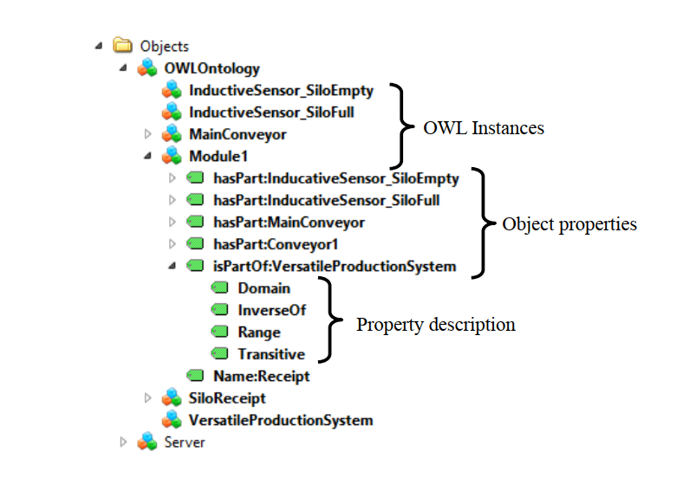
Integrating OWL Ontologies for Smart Services into AutomationML and OPC UA (Andreas Bunte, Oliver Niggemann, and Benno Stein)
Integrating OWL Ontologies for Smart Services into AutomationML and OPC UA
Transformation of OPC UA information model into OWL Representation.
Directly created RDF representation of OPC Model.
Main goal is to support AutomationML field.
Not all required knowledge is considered.
OWL full ontologies cannot be represented in the OPC UA information model and the individuals
Thus, does not generate helpful triples for OPC-UA
Not considered build-in functionalities of OPC-UA
Not considered the TypeReference

Slide 5
Proposed Approach
All TypeNodes & Instance Declation >> OWL Classes
ReferenceType Node >> OWL Object properties
Attribute >> OWL Data properties & Annotation Properties
OPC Instances >> OWN Individual
HasTypeDefinition-ReferenceType >> OWL Type assertion
HasSubType-ReferenceType >> subClassOf & subPropertyOf

Slide 6
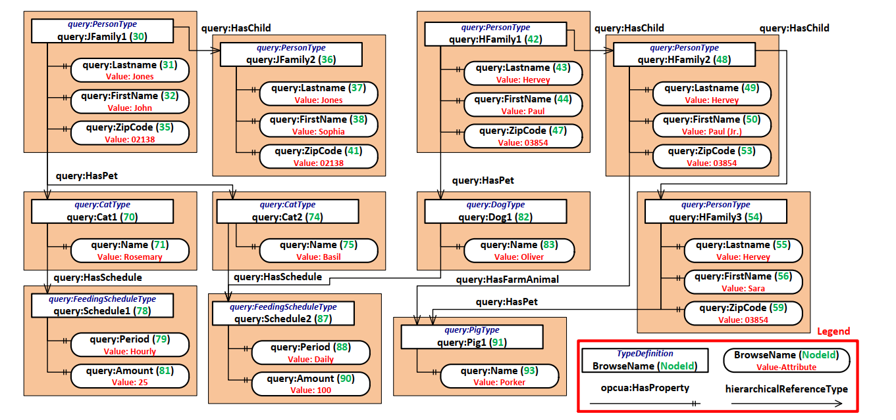
(Rainer Schiekofer, Michael Weyrich, 2020)

